Slide 1
Capstone Project - The Battle of Neighborhoods
Selecting the Best Location To Move to in Scarborough

Slide 2
Introduction/Business Problem
Scarborough is a popular destination for young adults to reside in. As a result, it is a diverse and multicultural area and is home to various religious groups and places of worship.
Assist young families in making better decisions on selecting the right neighborhood to move to in Scarborough.
The project conducts an analysis of housing prices and schools.
The information will be sorted by:
housing prices in an ascending or descending order
schools in terms of location, fees, rating and reviews
Retail Stores

Slide 3
Data Selection
The dataset consisting of latitude and longitude, and postal codes from Wikipedia. (Link to data https://en.wikipedia.org/wiki/List_of_postal_codes_of_Canada:_M)
Foursquare locational information will be utilized
1. Neighborhood
2. Neighborhood Latitude
3. Neighborhood Longitude
4. Venue
5. Name of the venue e.g. the name of a store or restaurant
6. Venue Latitude
7. Venue Longitude
8. Venue Category

Slide 4
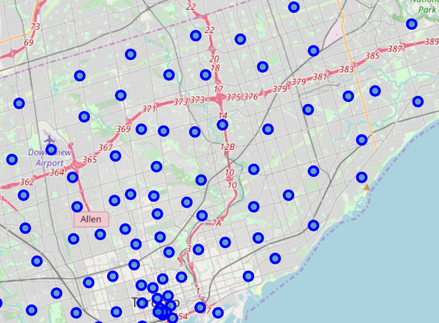

Slide 5
Methodology
Clustering Approach:
To explore the neighborhoods in Scarborough and group them into clusters to find similar neighborhoods
Work Flow:
Using Foursquare API features to data mine places in the neighborhoods
Due to http limitations the number of places per neighborhood parameter is set to 100 and the radius parameter would be set to 500.

Slide 6
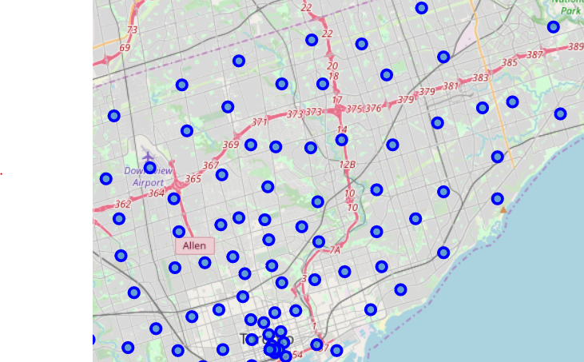
Results
Map of Clusters in Scarborough

Slide 7
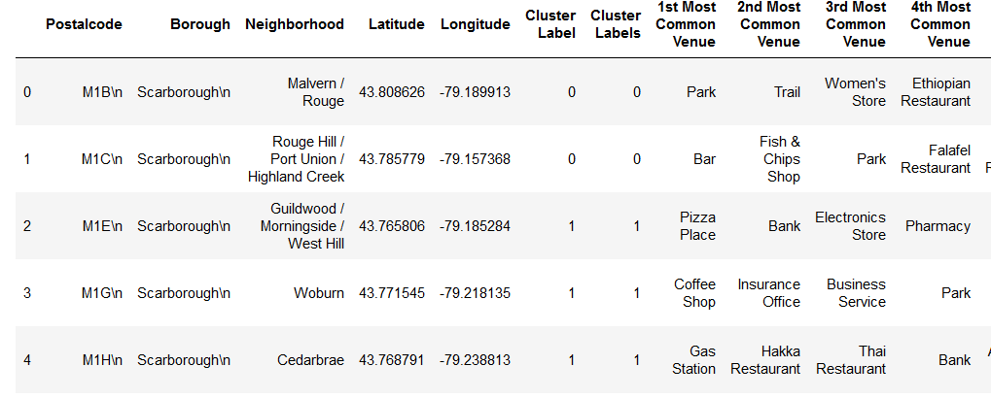
Results
Common Venues

Slide 8
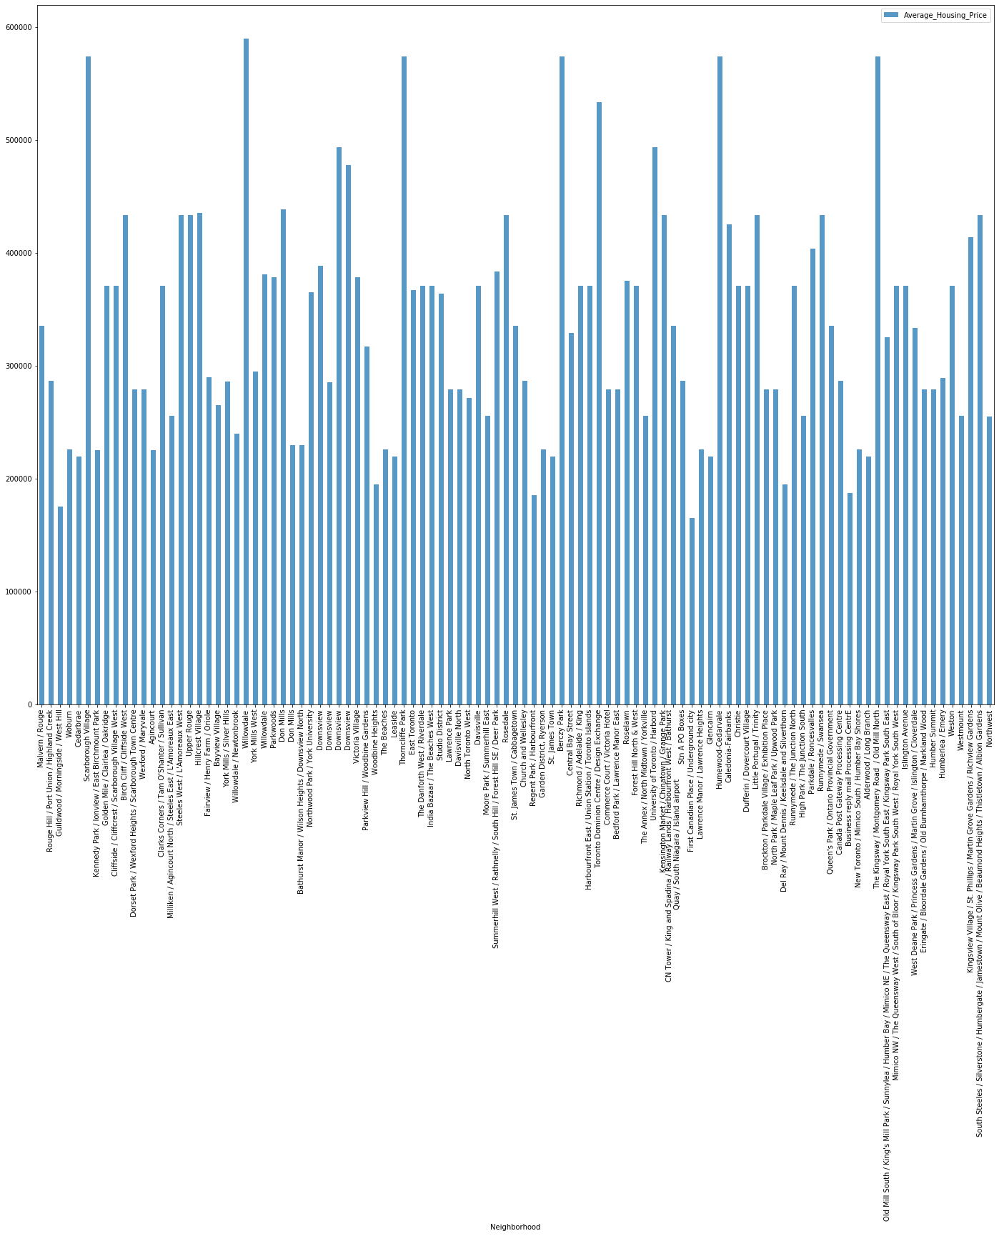
Results
Average Housing Price in Scarborough

Slide 9
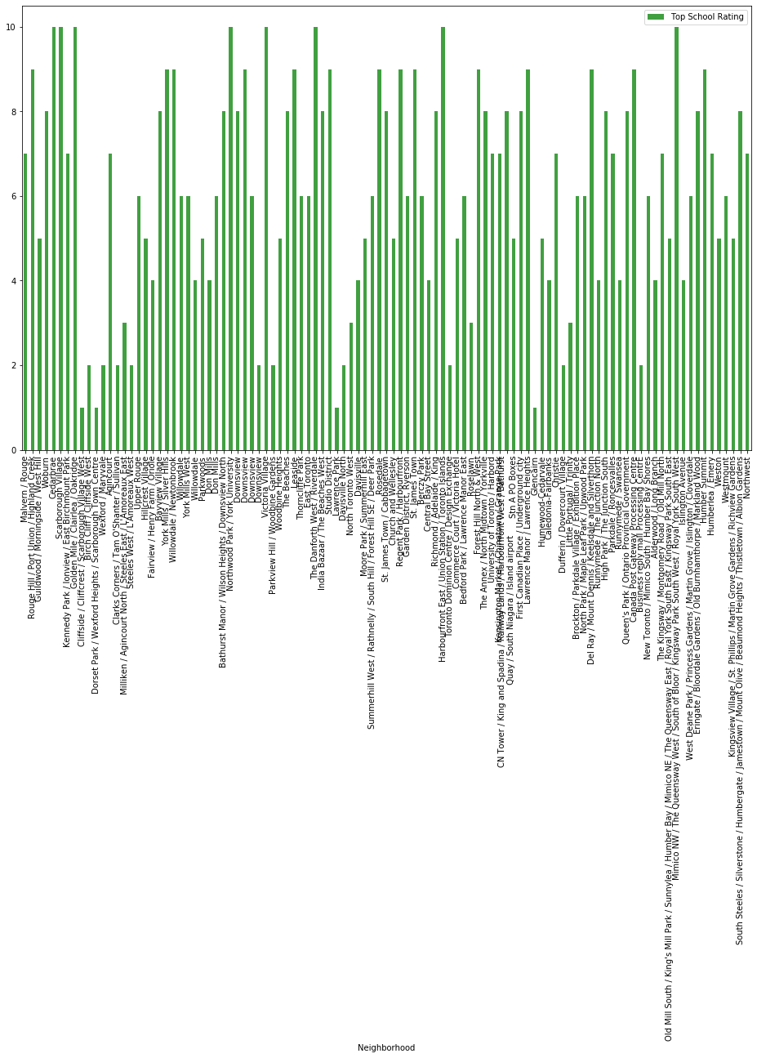
Results
School Ratings in Scarborough

Slide 10
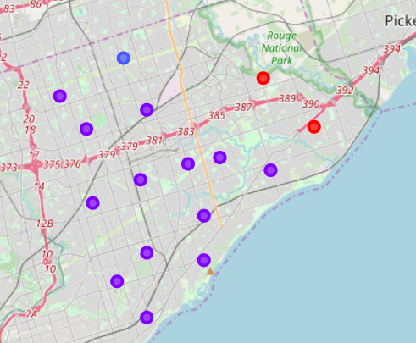
Result

Slide 11
Discussion
The major purpose of this analysis was to suggest the better neighborhoods in Scarborough for a person who are moving into the area.
Housing prices were sorted in a ascending order.
Schools were sorted list of by location, rating and reviews.

Slide 12
Conclusion
Using k-means cluster algorithm allowed me to separate the neighborhood into different clusters and for different lattitude and logitude from dataset, with similar neighborhoods located close to them.
Using the charts above the results presented particular neighborhoods based on average house prices and school rating..
I believing this course showed me a practical application to resolve a real situation impacting individuals personally and financially.

